Slide 1
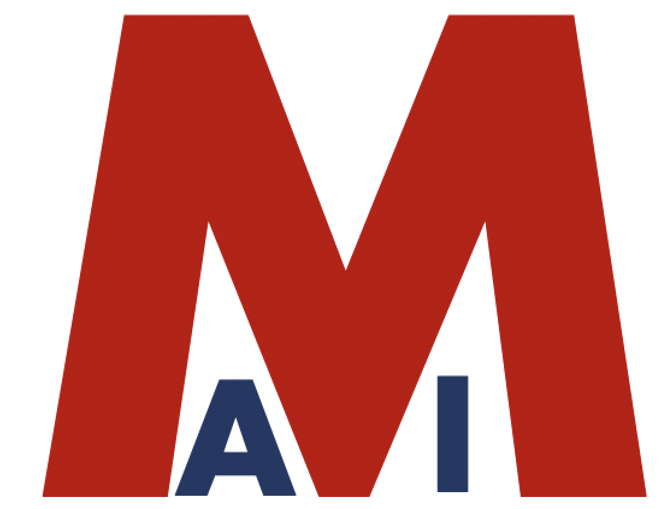
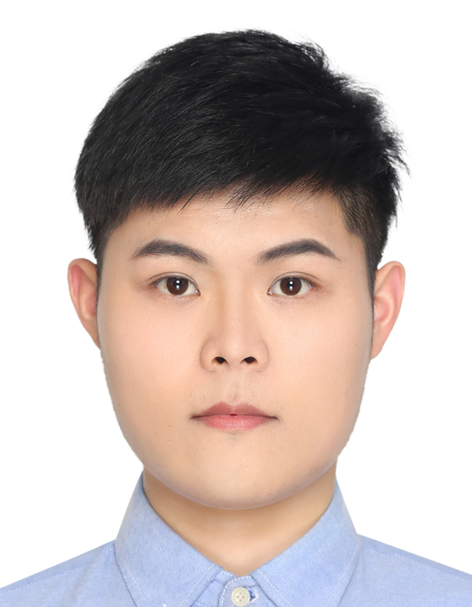
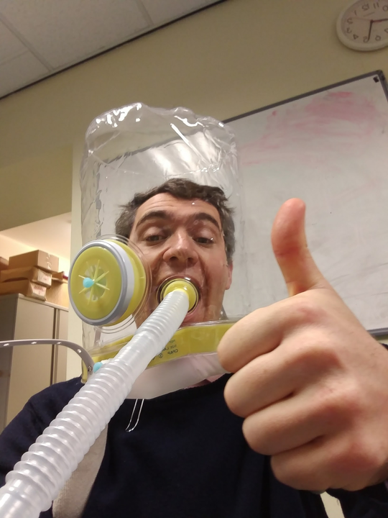
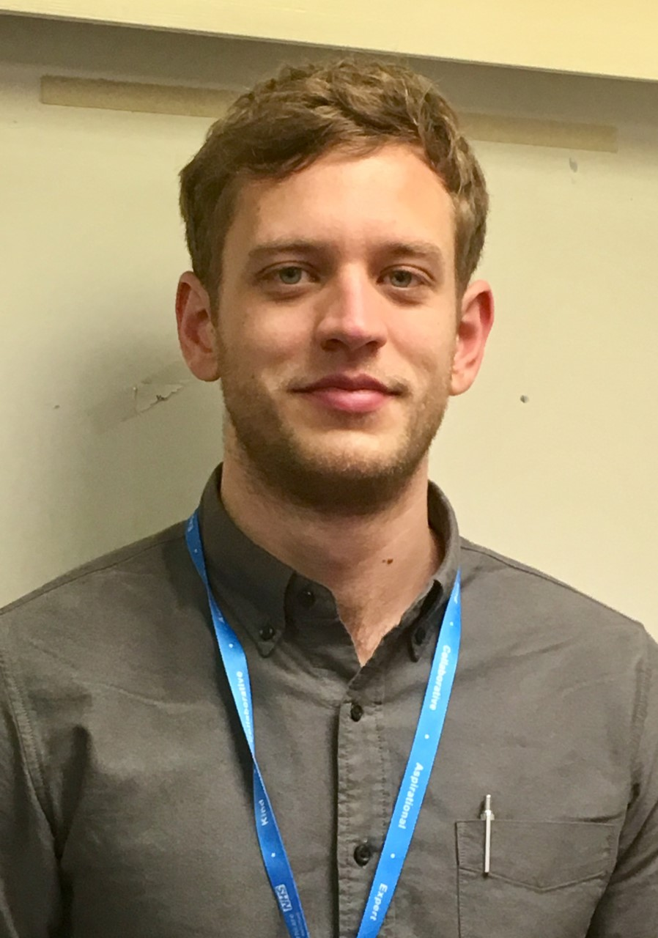
The Medical AI Group (MAI)
Zina Ibrahim
Overarching Aim: Develop explainable, reliable and robust computational models to perform predictive and prescriptive tasks in clinical and health settings.
Skills: deep learning, reinforcement learning, representation learning, domain knowledge representation.
Data: Time series, sparse dataset, label-free datasets, unreliably-annotated dataset, imbalanced distributions, missing data.
Domain: A multidisciplinary group building condition/setting/domain-agnostic models in medicine and healthcare.
Linglong Qian
Hugh Logan Ellis
Felix Dransfield

